Slide 1

Polygenic Risk Score (PRS)
step-by-step guide to BIGG SPOR project

Slide 2
What’s a Polygenic Risk Score?
A single numerical metric that estimates an individual’s genetic risk for a particular disease or trait (phenotype).
This score is calculated by summing the contributions of risk alleles carried by the individual, each weighted by its respective effect size as determined by a Genome-Wide Association Study (GWAS) specific to the phenotype in question.

Slide 3
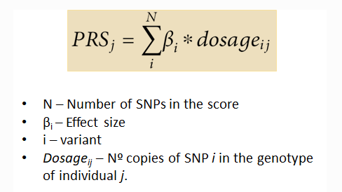

Slide 4
Effect size - βi
There exist two primary approaches:
Unweighted PRS, where each genetic variant is assigned a fixed weight of 1 (βi = 1).
Weighted PRS, which employs the actual effect sizes, typically represented as betas (βi) or Odds Ratios (OR), derived from GWAS specific to the phenotype in question.

Slide 5
PRS applications
Disease risk prediction
Screening and prevention.
Personalized treatment
Epidemiological Studies
Drug Development

Slide 6
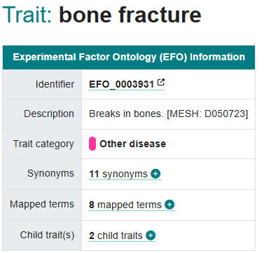
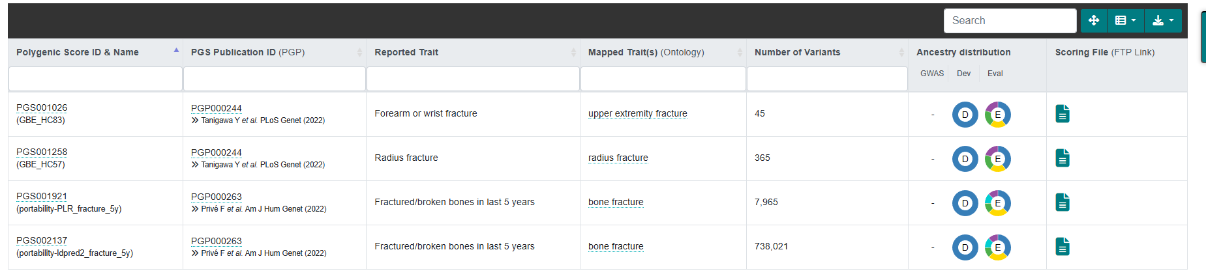
Required Data (example)
SNPs DATA. List of SNPs associated with a Trait of interest

Slide 7
Harmonise each model to one genome build (e.g., hg19 or hg38):
keep SNP-only, biallelic-only
enforce ALT = effect allele (A1)
flip beta sign when needed
output per model: varid (chr:pos) , ref , alt , A1 , beta
stack rows and add model column (PLR / LDpred2)
Choose the ancestry group most similar to the Turkish population for downstream evaluation/interpretation.

Slide 8
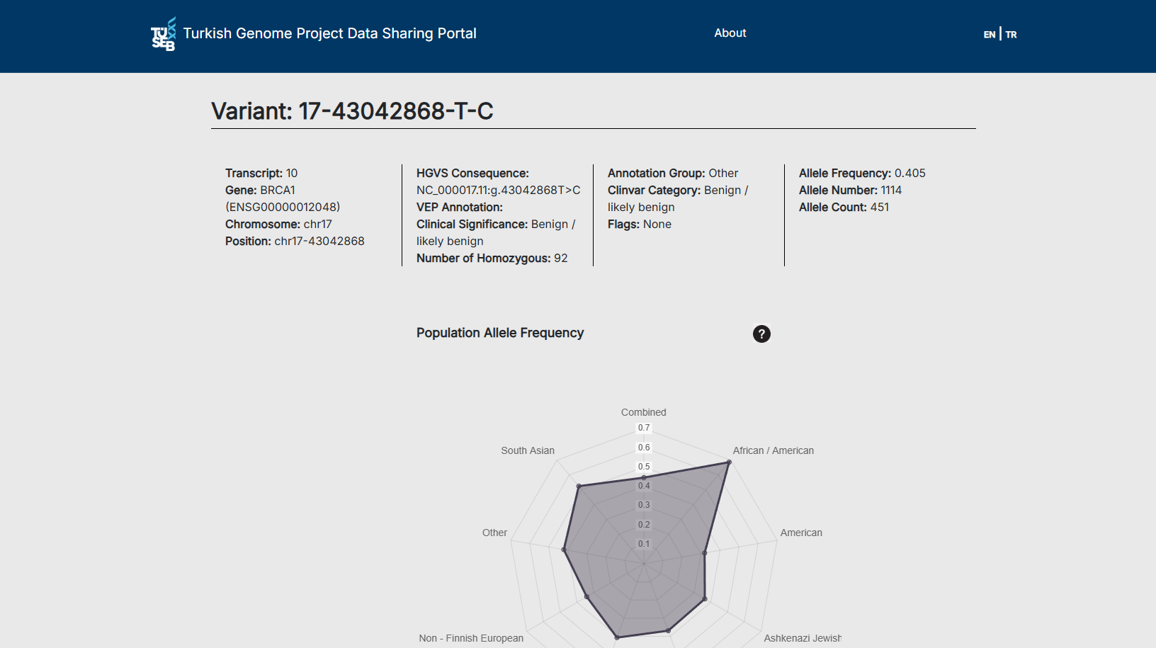
Required Data (example)
Selected trait-associated SNPs and retained those present in the Turkish population database.
PGS (bone fraction trait) = around 700K
Turkish = 2979
Model one (penalized logistic regression) PLR
Model two (linkage disequilibrium pred2) LDpred2

Slide 9
QC TGD output:
  drop not found
  drop missing AF/AC/AN
  drop allele mismatches (PGS vs TGD ref/alt)

Slide 10

Final Turkish panel list:
panel.PRSxTGD.txt = SNPs present in both PRS model(s) and TGD

Slide 11
To sum up:
Use the ancestry group reported in the original publication (training/validation cohorts) that is most comparable to the Turkish population for downstream evaluation and interpretation, because PRS performance and calibration vary across ancestries.

Slide 12
References
Wand H, Lambert SA, Tamburro C, et al. Improving reporting standards for polygenic scores in risk prediction studies (PRS-RS). Nature (2021). (PMC)
PGS Catalog documentation: Ancestry reporting / ancestry description framework used by PGS Catalog (aligned with GWAS Catalog framework and PRS-RS). (pgscatalog.org)
Lambert SA, et al. The Polygenic Score (PGS) Catalog: new functionality and tools… (includes normalisation/interpretation using ancestry-aware reference distributions / similar populations). Nucleic Acids Research (2024). (PMC)
Privé F, et al. Portability of 245 polygenic scores when derived and applied in multiple ancestry groups within the same cohort. American Journal of Human Genetics (2022). (ScienceDirect)

